Slide 1
NEWSLETTER
January 2023
Welcome back
A huge welcome back to everyone. I trust you all had a lovely break after what was a long and cold Autumn term. We start this term excited about the events and learning planned. We hope that your child enjoys a healthy and packed Spring term here at Old Park.
Attendance
I am pleased to say that our daily attendance since our return in January has drastically improved since December. As a school we saw very high rates of absence due to various illnesses before Christmas. We hope that the children will now have a much healthier 2023. It is so important that children attend regularly. Our target for attendance in 2023 is 96%, a target that we reached easily and often exceeded until 2020.
We appreciate that children will be unwell and there may be exceptional circumstances that affect your child’s attendance but a target of 96% allows for this. To reach their target across the year your child will have to have less than 7 days absence across the academic year. Seven days absence is equivalent to a minimum of 28 missed lessons. I know that many children will exceed this target but hope that the majority do reach it so they can get the most out of their learning and the offer we provide.
Trips, Visits and Events
Our Y6 cohort enjoyed their visit linked to their World War Two history unit to the National Memorial Arboretum last week. This week a number of children from Y3 - 6 took part in the 1st of nine Young Voices events held at the LG Arena. Young Voices is a national event hosted by cities across the UK in January & February. The children had an amazing time singing with thousands of children from schools across the midlands and beyond. Also this week, Y3 took part in their Career Hub event where they explored the Animal Care industry.

Slide 2
Calendar Days Live Annual Calendar Please find attached the link to access the live annual calendar for 22/23, this link is also available on the school website. This is a live document so please check it regularly. Within this document you will find the term dates for this year. https://docs.google.com/document/d/1IxaPPPmojUjel07jGEBw4M67DMXXGzCA1eWyN0CGZB8/edit#
January 2023
Friday 13th | Swimming - 3P
Tuesday 17th | Y6 SATs parent briefing (live event) 3.20pm School Hall (slides will be shared on Google Classroom for Parents who are unable to attend)
Friday 20th | Swimming - 3P
Tuesday 24th | Y4 Multiplication Check Parent Briefing (virtual event) 4pm
Friday 27th | Swimming - 3P
Tuesday 31st | Y2 SATs Parent Briefing
February 2023
Friday 3rd | Swimming - 3P
Wednesday 8th | Exploration Day for EYFS, Y1, 2 & 3
Thursday 9th | Exploration Day for Year 4, 5 & 6
Friday 10th | Swimming - 3P
Monday 13th | Gratitude Week
Tuesday 14th | Safer Internet Day
Wednesday 15th | Year 3 History Experience Day
Thursday 16th | House Attendance Winner - Non-Uniform Day (for the winning house only).
Friday 17th | Non-uniform wear Monty Blue - School Values Day 50p to school fund Swimming - 3P School closes for Half Term
Monday 20th | HALF TERM
Monday 27th | Training Day
Tuesday 28th | School re-opens Children will be creating their t-shirts for World Book Day, Children to bring in their design ideas today.

Slide 3
How safe are your children online?
Do you need support?
Follow these link to safety guides on the NSPCC website:
https://www.nspcc.org.uk/keeping-children-safe/online-safety/#guides
This includes support for online games, social media and internet connected devices.
Keeping your children safe
The Nurse team visited us last week to talk to our Y2 cohort about being safe and pants being private.
For more information follow this link:
https://www.nspcc.org.uk/keeping-children-safe/support-for-parents/pants-underwear-rule/
ARBOR PAYMENTS
AS THERE HAS BEEN SOME ISSUES WITH PAYMENTS ON ARBOR, CAN WE REMIND PARENTS TO PAY FOR THEIR SNACK, MILK, SCHOOL FUND AND OTHER ITEMS APART FROM TRIPS VIA THE ‘SCHOOL SHOP’. PLEASE DO NOT MAKE ANY PAYMENTS ON THE ‘CLUBS’ SECTION
SCHOOL LUNCHES - SCHOOLGRID
The menu for the rest of the term is available on SchoolGrid, all pupils who are in Reception to Year 2 are entitled to a free school lunch.
Please remember to book your meals and make payment if necessary.
If your child is off school, please cancel their school lunch by 8.00am on that morning on SchoolGrid.

Slide 4
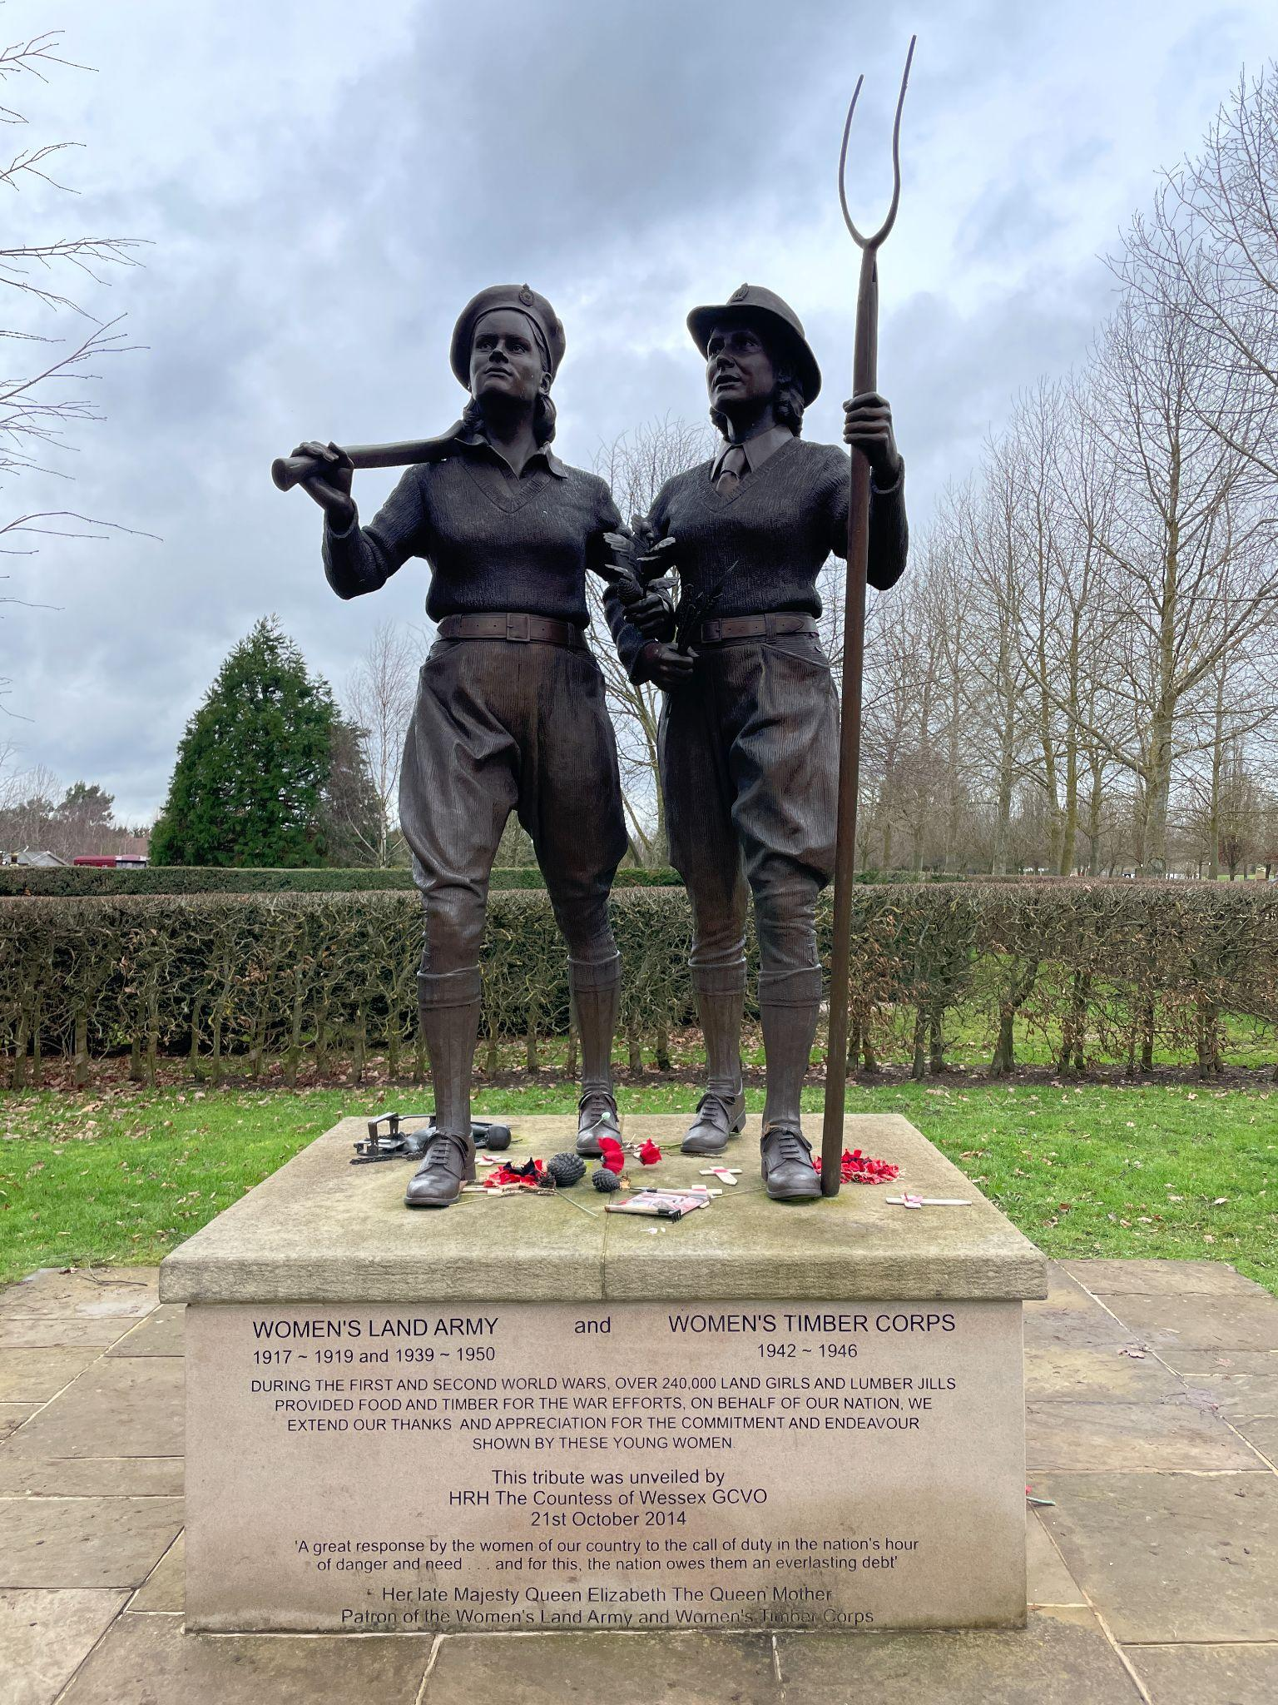
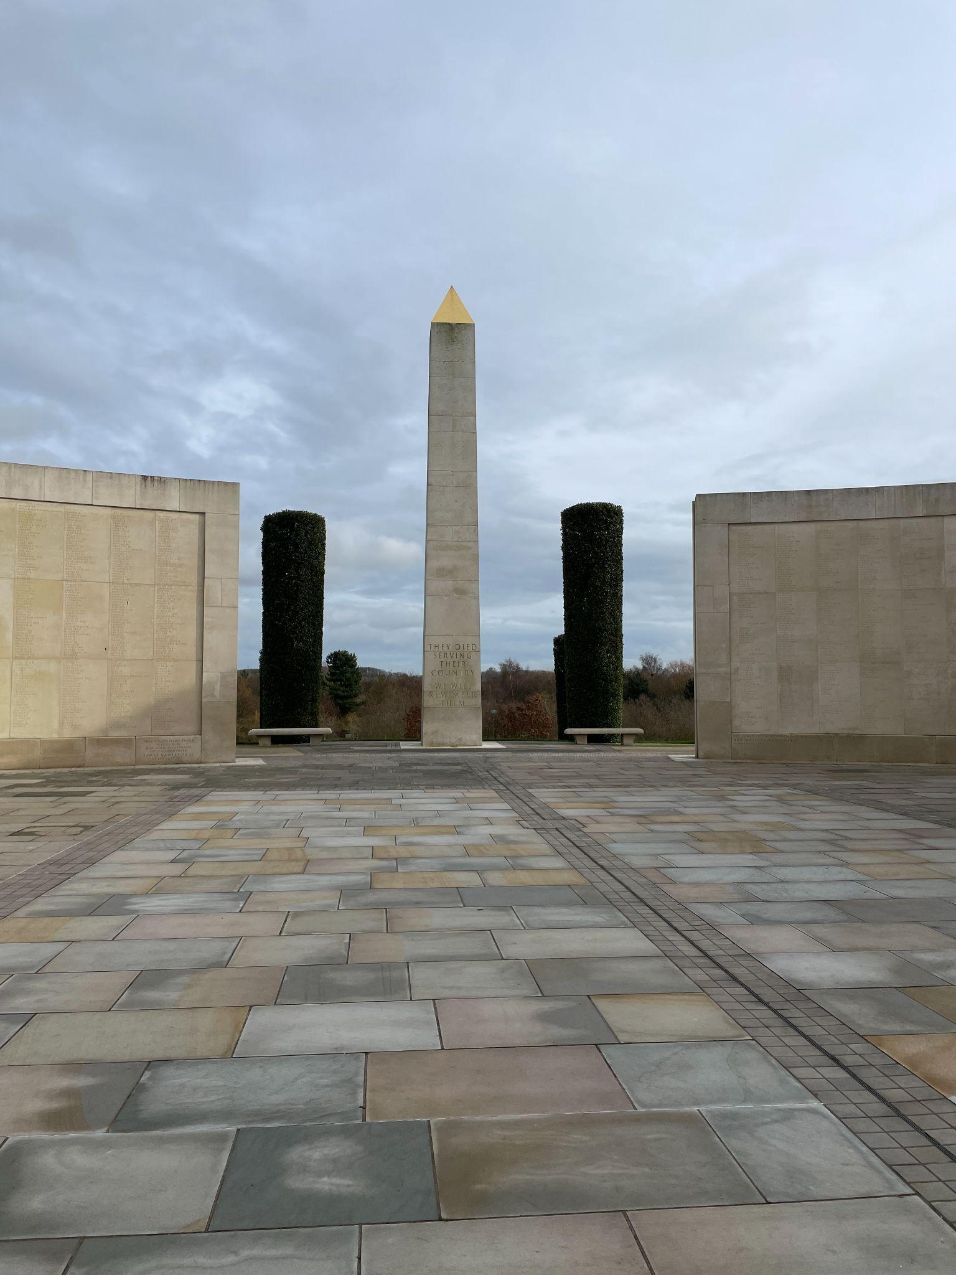
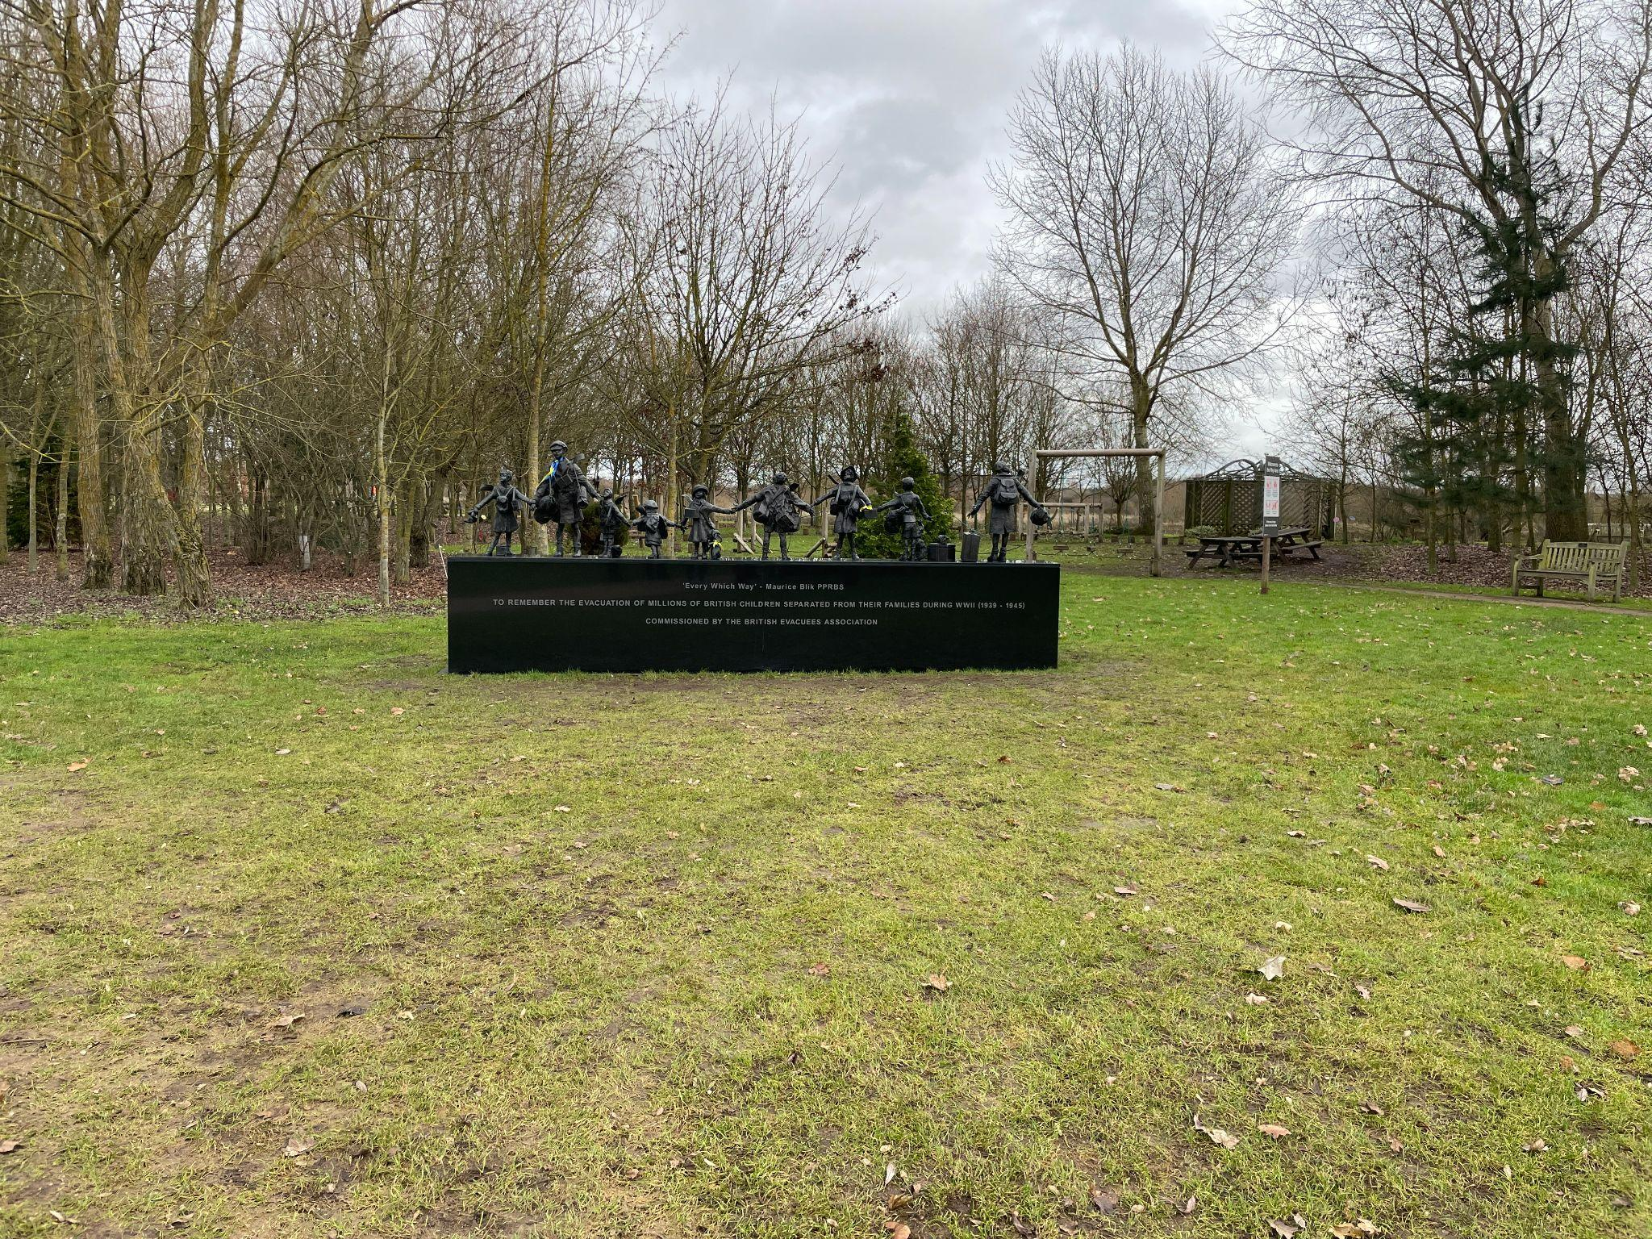
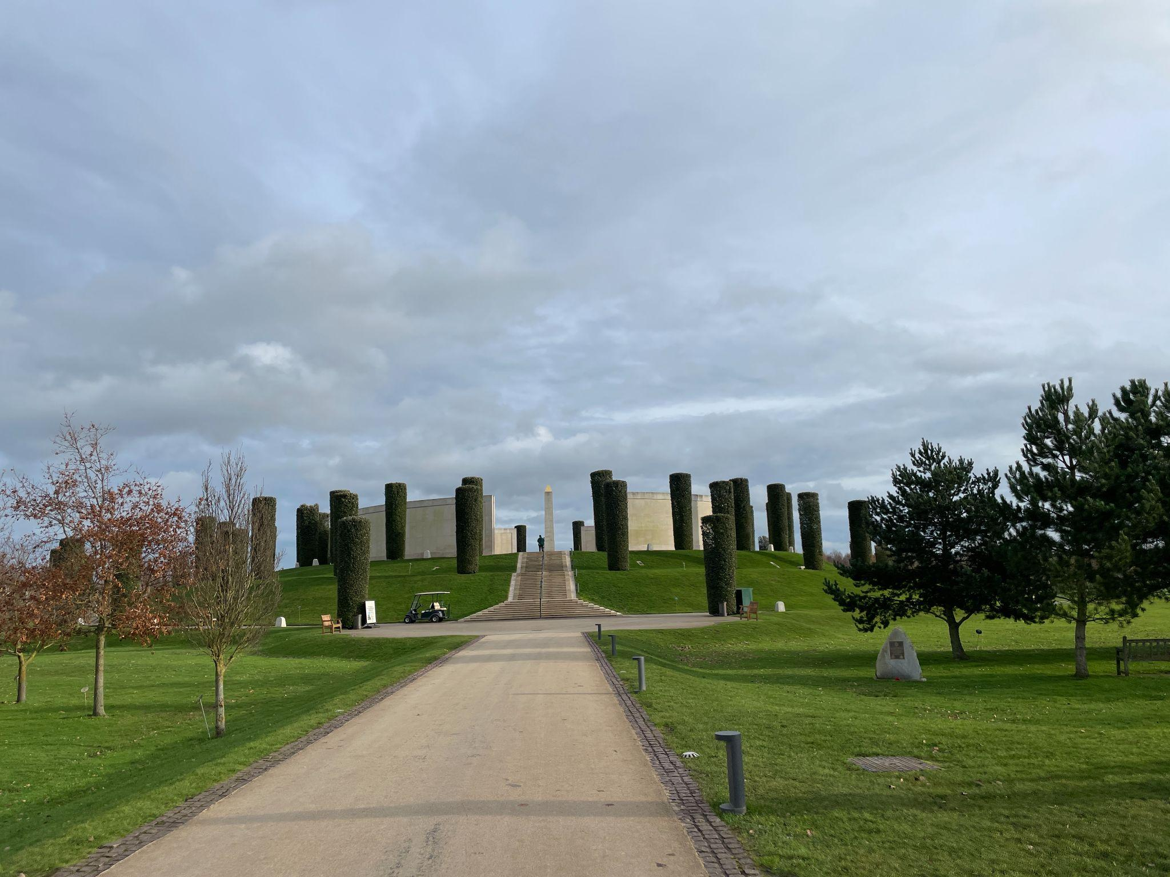
To kick-start our first week back, Year 6 visited Alrewas National Memorial Arboretum as an introduction to our World War Two history topic. The Arboretum is a 150-acre site filled with breath-taking memorials dedicated to celebrating lives lived and commemorating lives lost. The children studied each memorial, looking for examples of symbolism. To pay their respects, the children conducted their own act of remembrance where a wreath was laid. The children enjoyed learning about children's experiences of evacuation and completed a problem-solving task where the billeting officer had dropped all of his information about the evacuees; they were tasked with working out where the children had evacuated from, where they were being evacuated to and what their new life looked like. Year 6 thoroughly enjoyed their day and are excited to further develop their knowledge of World War Two in History lessons.

Slide 5
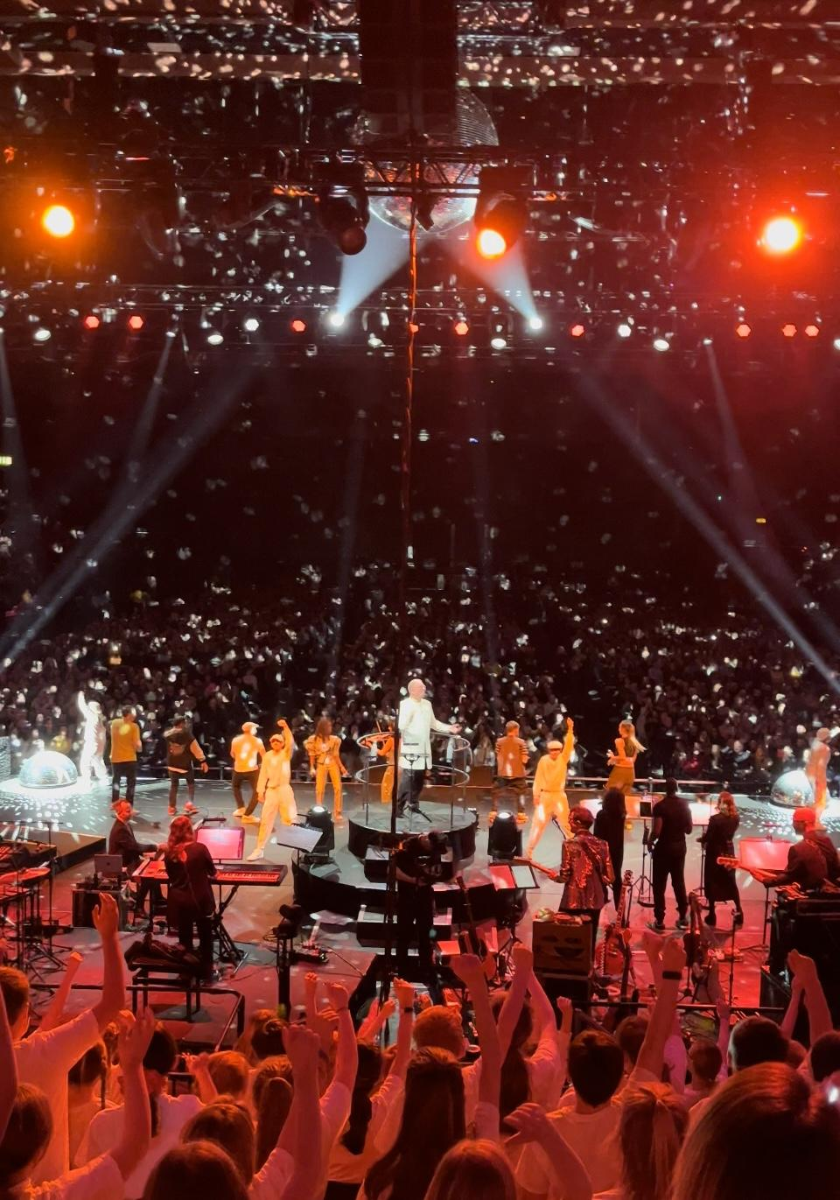
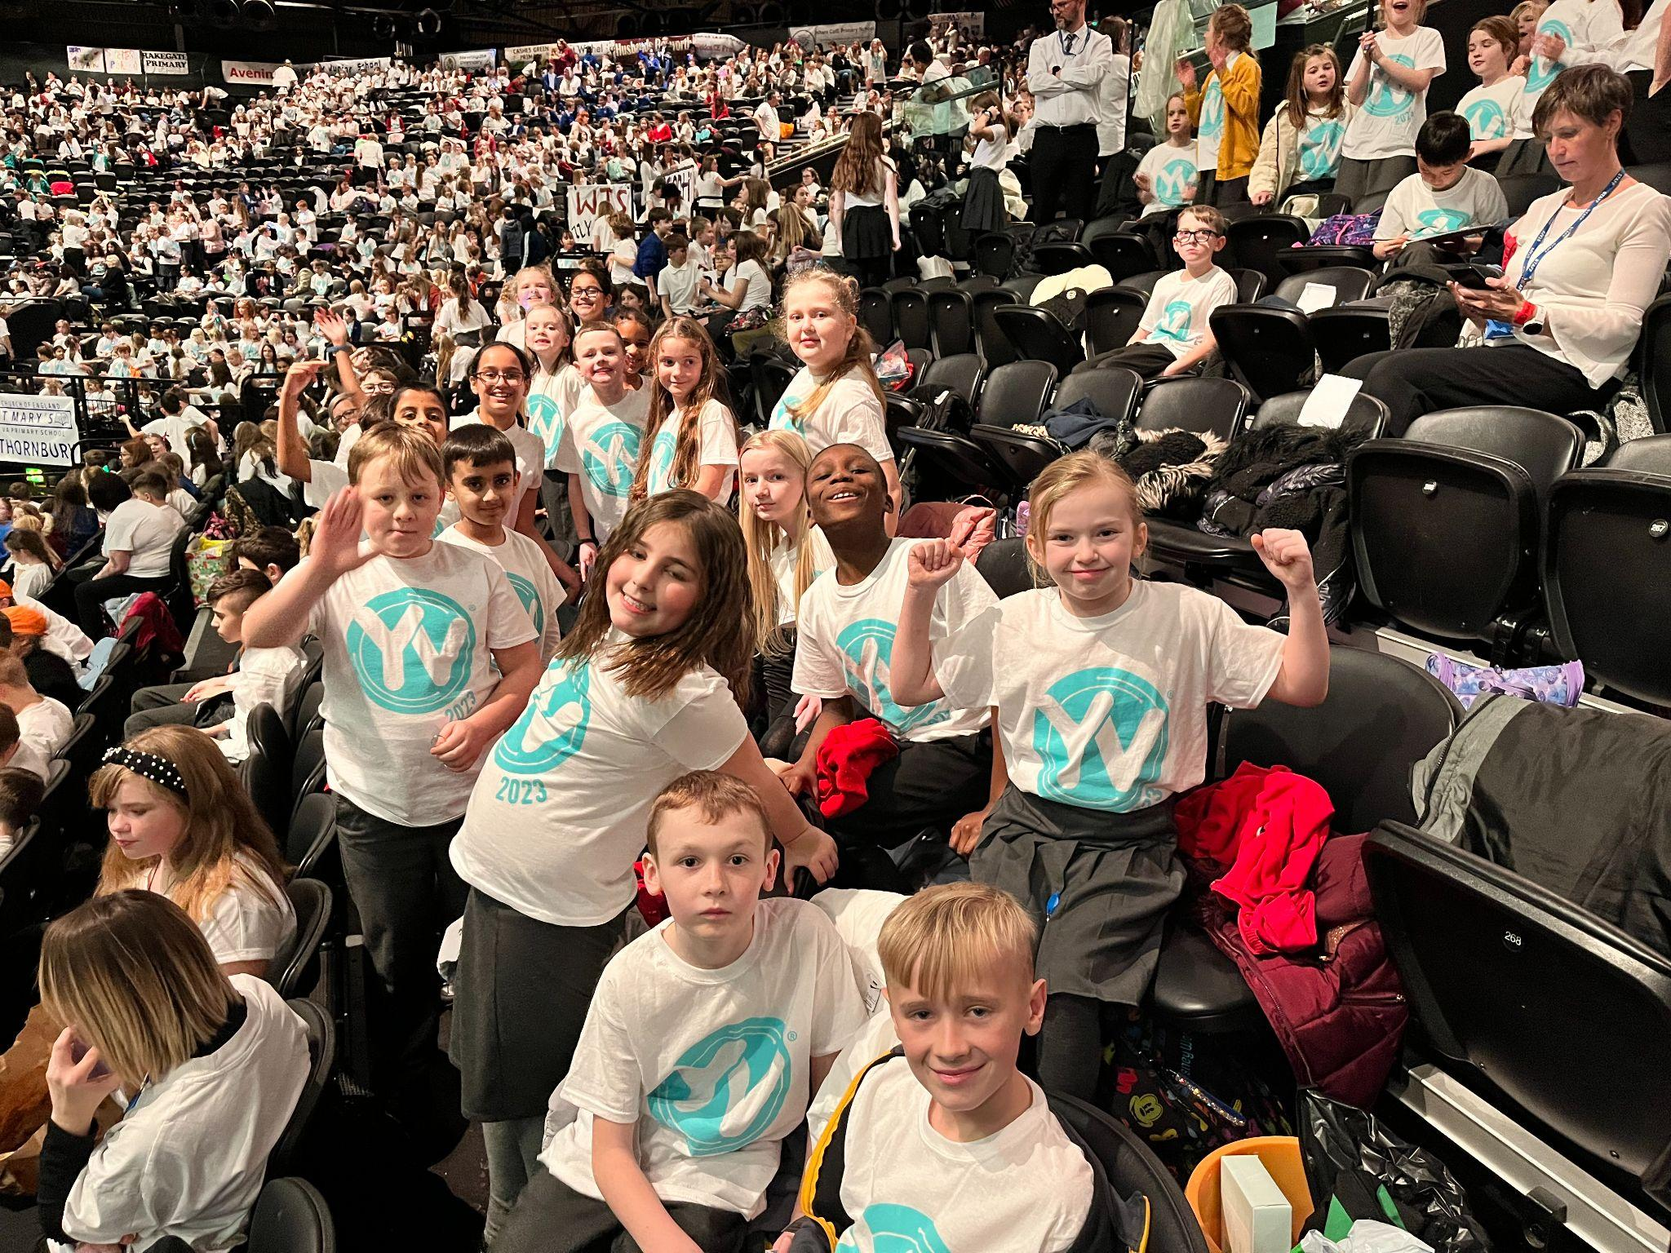
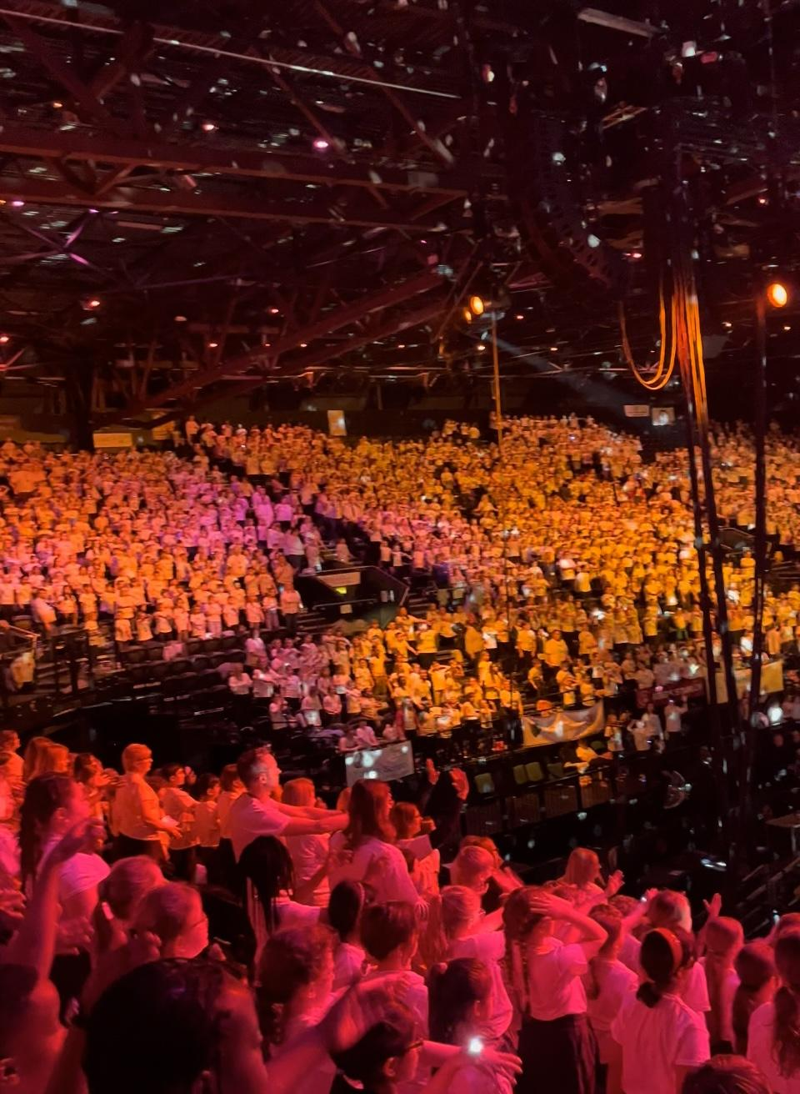
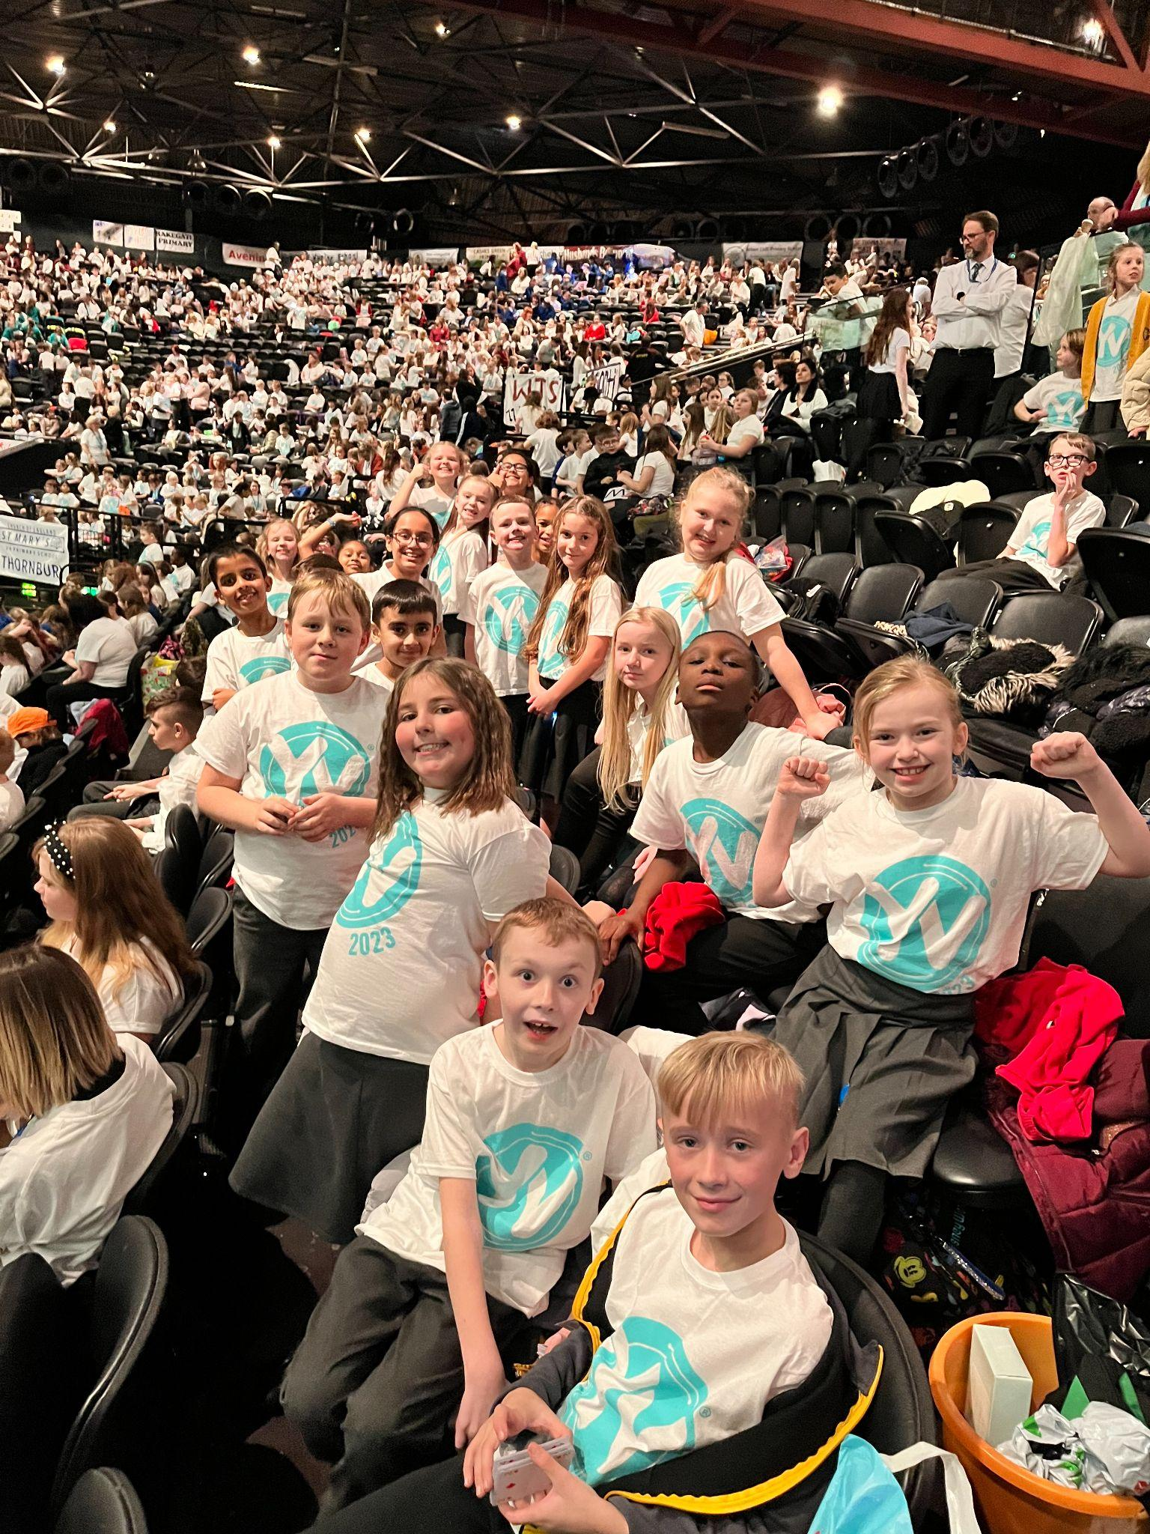
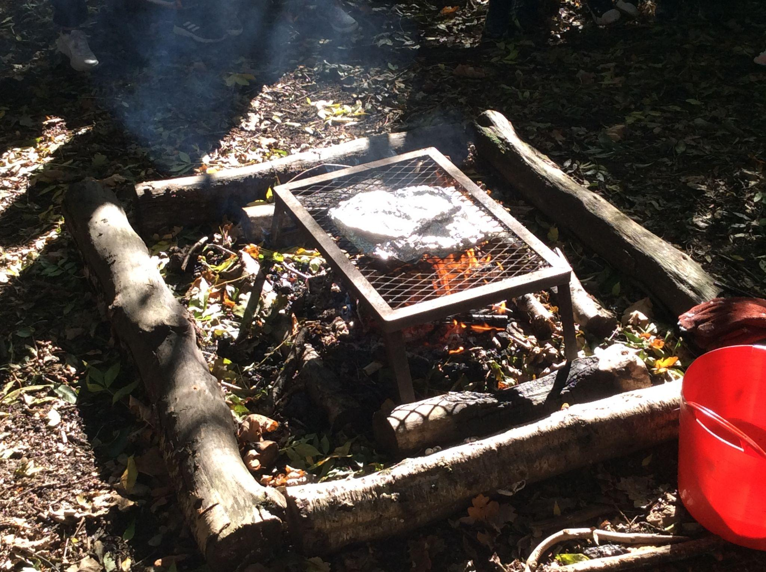
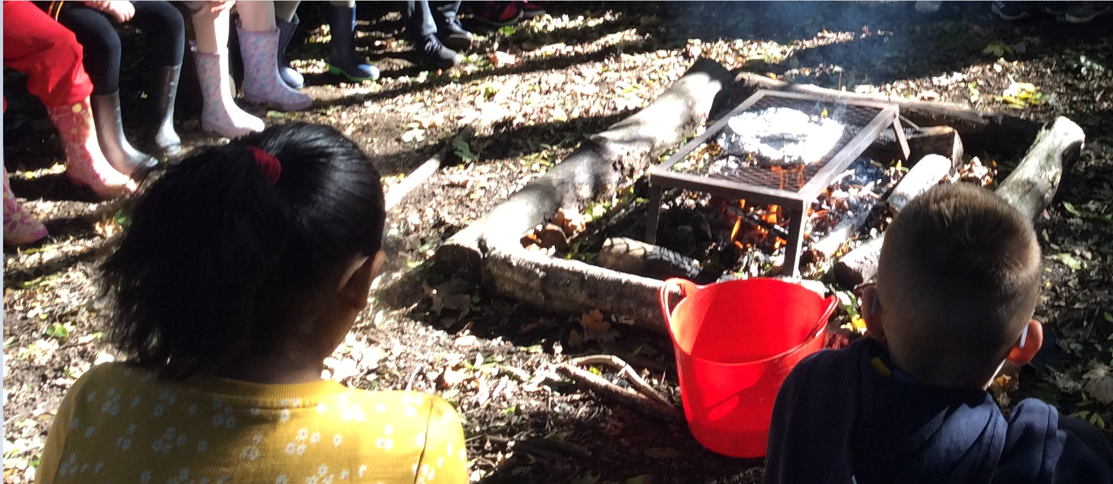
Young Voices 2023
After a two year absence, Old Park was back performing at the Resorts World Arena alongside 6,000 other children in the Young Voices choir, the largest children's choir concert in the world. From beat-boxing lessons to performing with Heather Small, the children thoroughly enjoyed the day. The concert is a culmination of a lot of hard work and dedication from the children, attending weekly rehearsals throughout the autumn term. This invaluable experience supports the children's self belief, motivation and confidence.
Forest School Year 4
Before Christmas Children in Y4 enjoyed the opportunity to learn through practical experiences and taking their learning outside the classroom. They were able to explore baking on an open fire using bronze and Iron age techniques. They learned about the different tools that may have been used during these times. This also provided the children with a great opportunity to connect their learning in the Design and Technology unit of baking bread where the children learned about the bread making process.

Slide 6
December Star Pupils
Class |  | Reason
Nursery AM | Edie | For always trying her best and being a great example to others.
Nursery PM | Remi-Jai | For trying hard & managing so much more.
Nursery 30 | Emilia | For always trying hard and making lots of progress.
RB | Aaqib | For always being sensible and hard working.
RR | Darcie | For being brave with new challenges she faces.
1G | Marlie | For being a role model to her peers and for showing perseverance when practising for our Christmas assembly- she was a superstar!
1JT | Taiyon | For showing kindness towards others
2H | Lily T | For always working hard and always having a positive outlook.
2T | Oyin | For always being kind and polite to everyone.
3P | Keelan | For trying very hard in all subjects.
3W | Eliza | Eliza has a really positive attitude to learning and engages in all subjects.
4W | Shreeya | For a conscientious attitude towards all her lessons.
4S | Rainah | For excellent listening skills and focused on her learning.
5C | Alexa | For trying her best in Maths and developing confidence. Well done Alexa - keep up the good work.
5W | Ellie | For always coming into a school with a smile on her face, making others smile throughout the day, having an excellent attitude towards her work at all times and generally embodying all of the Old Park School Values.
6M | Kallum | Kallum has worked really hard and has been really kind to everyone in class.
6W | Millie | Millie for being a caring friend to others and showing enthusiasm in all lessons.

Slide 8
Admission Arrangements – September 2023 The application for parents of current nursery children (D.O.B: 1/9/2018-31/8/2019) to apply online for a reception place opened on 12th September 2022. Please note, the closing date is 15th January 2023. Can you please inform the school office when you have completed your online application either by ringing or emailing school.office. Please check you have received an online receipt as confirmation you have submitted your application correctly. It is important to keep this receipt safe.
National School Funding - For your information As you may be aware, lack of school funding is causing difficulties in schools across the country, it is impacting the provision that that schools are able to deliver. This is impacting and will continue to impact on staffing and resources in schools nationally unless there is change. Below are links to various website that share the challenges facing schools. If you google school funding you will find many more articles that share information about the situation. https://www.naht.org.uk/Our-Priorities/Funding https://www.theguardian.com/education/2022/aug/02/schools-in-england-face-funding-crisis-as-costs-soar-study-warns https://schoolcuts.org.uk/story/funding-crisis-explained/ If you feel strongly about these issues you can contact your local MP.

Slide 9
Arbor The school is using Arbor for all School Communication, School visits, Parent Consultations, and some Payments (School Fund, Milk, Snack & Trips). You will also have access to your child’s pastoral information via the portal. We have created a Parent Portal account for you. To finish creating your Parent Portal account you need to set a password. Your username is the email address we’ve sent this email to. Please go to https://login.arbor.sc and click Forgot your password? to finish setting up your account. How to access the Portal/Application The Parent Portal is accessible to Parents on a laptop or computer. The Arbor App is the mobile version of our Parent Portal for use on mobile devices such as smartphones and tablets. The Arbor App can be downloaded from either the Playstore on android phones or the Apple Store on iPhones (please see the attached leaflet). As this will be our only way of communicating with you, all parents will need to log onto the Parent Portal and download the app to their smart devices.. If you have any queries, please contact school.office@oldparkprimary.com. The Arbor app also has the facility to message the school and you can use this method once you have set up your Arbor login.
Breakfast Care Provision The School provides a breakfast provision. If you are interested in applying for annual membership please contact: breakfast@oldparkprimary.com Please be aware that there may be a waiting list. If your child is poorly and unable to attend Breakfast club please email the above email address. Regular annual membership is from 7.45am/day Early bird annual membership is from 7.30am/day Parents are reminded that if children are absent either for sickness or holiday, payment for days missed will still need to be paid. Payments are made through a Standing Order payable on 28th of each month for 11 months (not July 28th). Please read our policy and terms and conditions before applying for annual membership. The policy can be found on the school website.

Slide 10
The school office staff are available from 8.15am-4.30pm (Monday-Thursday) and 8.15am-4.00pm (Fridays). 0121 526 2669.
Any queries please call or email school.office@oldparkprimary.com or call 0121 526 2669. You can also message via Arbor.
If you telephone the school before 8.15am and after 4.30pm, you will hear the following message and options:-
Please leave a message or call back during our open hours or alternatively email school.office@oldparkprimary.com
Press 1 for the Patch Day Nursery and After School Club
Press 2 to report your child’s absence (voicemail)
Press 3 to leave a message after the beep (voicemail)
YOU CAN ALSO SEND AN IN-APP MESSAGE VIA ARBOR TO REPORT AN ABSENCE
School Places
We have spaces available in years: 3 & 4 in school, if your child has a sibling or you have relatives interested in attending our school please email: school.office@oldparkprimary.com
Out of School Club
As you may know The Patch Day Nursery runs an out of school provision on site and currently has some availability.
The out of school club staff collect the children from the classes at home time and children can stay until 5pm or 5:30pm depending on the package you chose.
Payments are made on a place basis not on attendance and fees are paid on a monthly basis on the 1st of each month.
If you would like any further information about the club or would like to book a place please email outofschoolclub@thepatchnursery.com. Please contact the out of school using this email and not contact the school office.

